Slide 1


Data and
Srinidhi Shukla

Slide 2

Let’s talk about
Data
Data Science vs. Data Analysis
Data Visualization
Tableau

Slide 3

What is Data?

Slide 4


Slide 5

It is basically everything around you

Slide 6
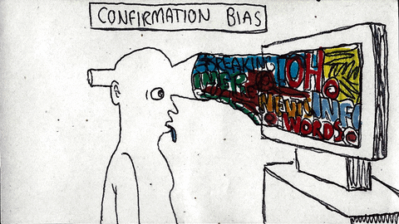
Wait what!? All of it?

Slide 7

A piece of
Information
Fact
Measure
Image
Video Clip
Audio Clip

Slide 8

Okay! So, what do we do with this data?
Before that, it is important to know, how to
Gather/collect the data
Make the data meaningful for our analysis
Use the data
Derive the insights and present them

Slide 9
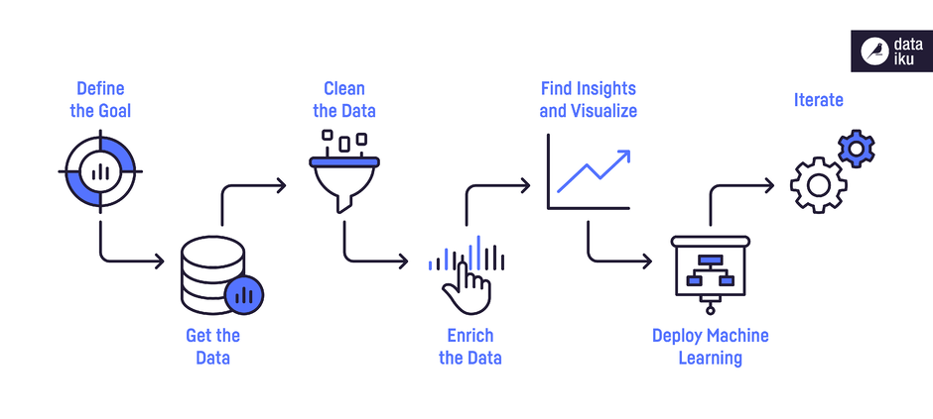
How would you describe the process?
Visualization comes in here!

Slide 10
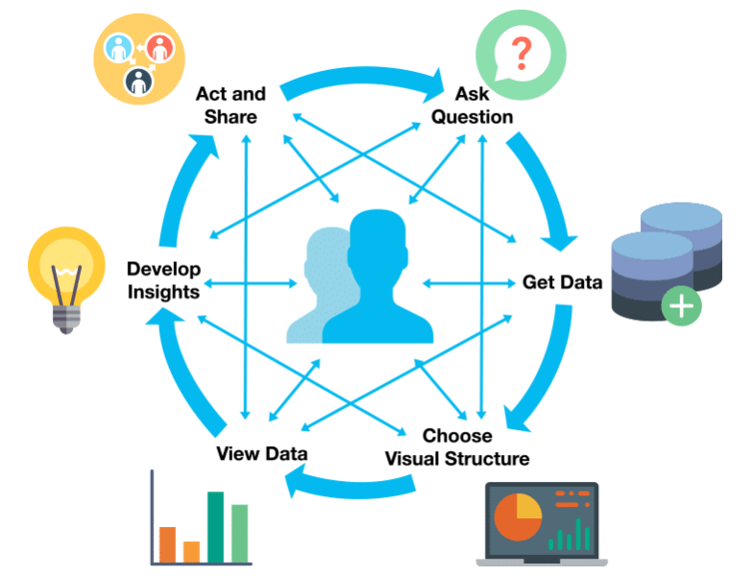
What are the steps in Data Visualization?

Slide 11
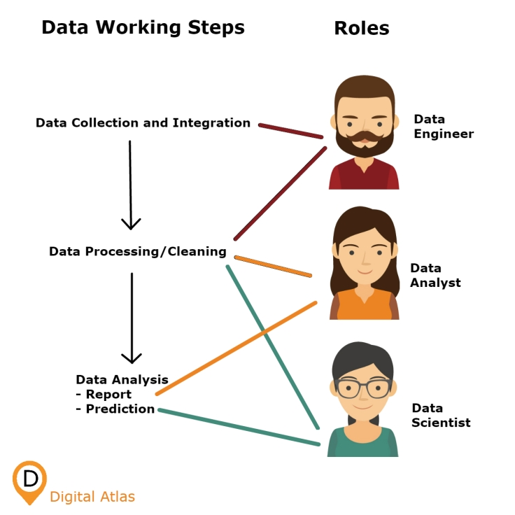
Oh! So, all that is our job?

Slide 12

Okay! So why exactly are we doing all this?

Slide 13

The goal is straightforward, to make better decisions!

Slide 14

What is data visualization and what’s with the hype ?
High-level overview of the data’s key highlights.
Enables to understand the meaning of the data in a manner that leads to fresh ideas.

Slide 15

Why Tableau?
User friendly
Apply to any business
Fast and easy
No coding required
Multiple data resources

Slide 16




Tableau Products
Tableau Desktop Create FOR ANYONE
Tableau Server Share & Create FOR ORGANISATIONS
Tableau Reader Share FOR ANYONE
Tableau Server Share & Create FOR INDIVIDUALS & ORGANISATIONS

Slide 17
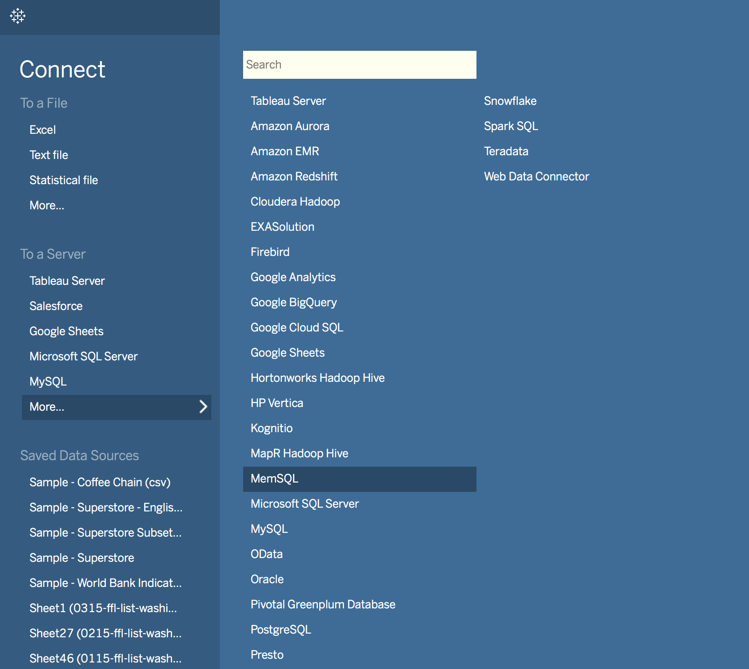
Data Sources

Slide 18
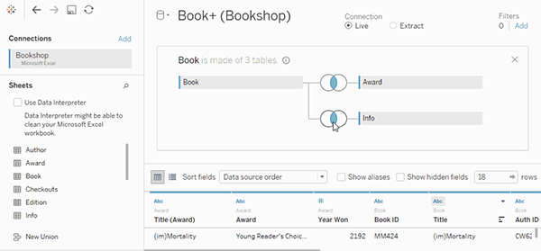
Joins

Slide 19
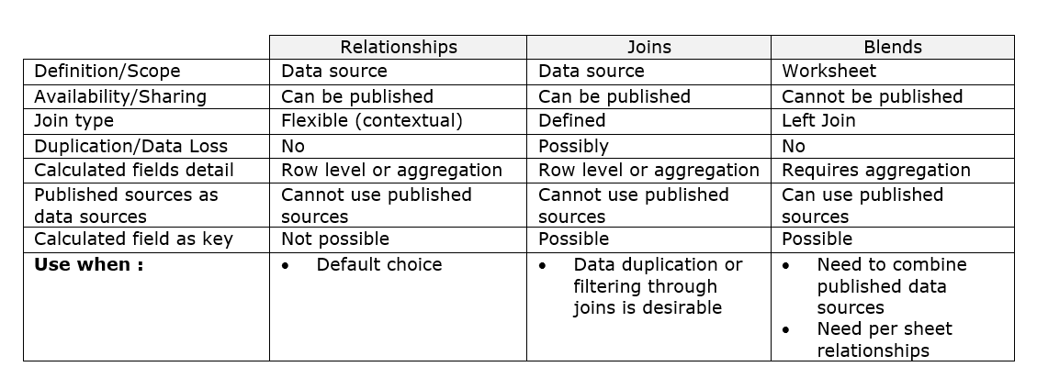
Relationships vs Joins vs Blends

Slide 20
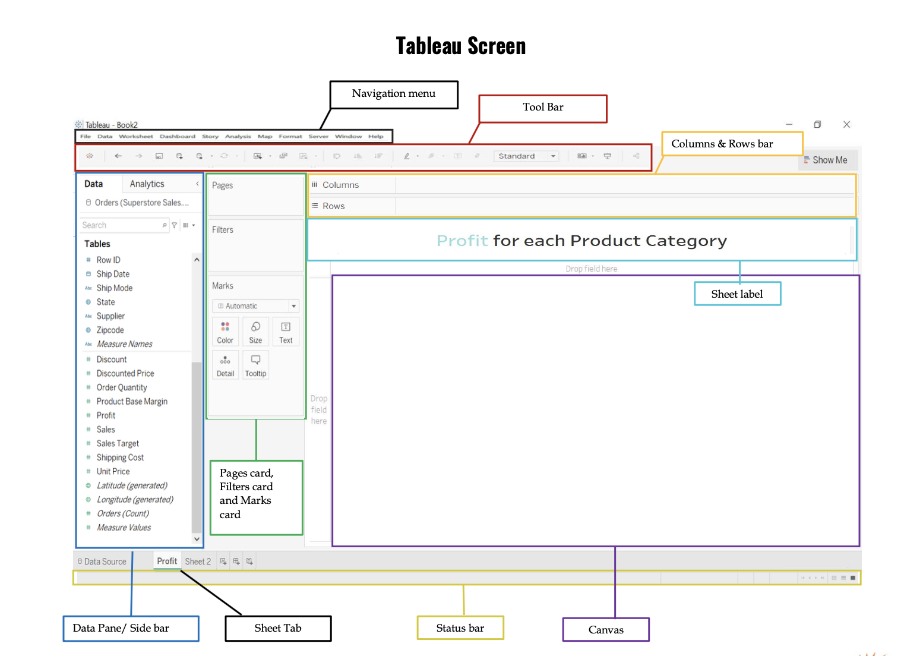

Slide 21
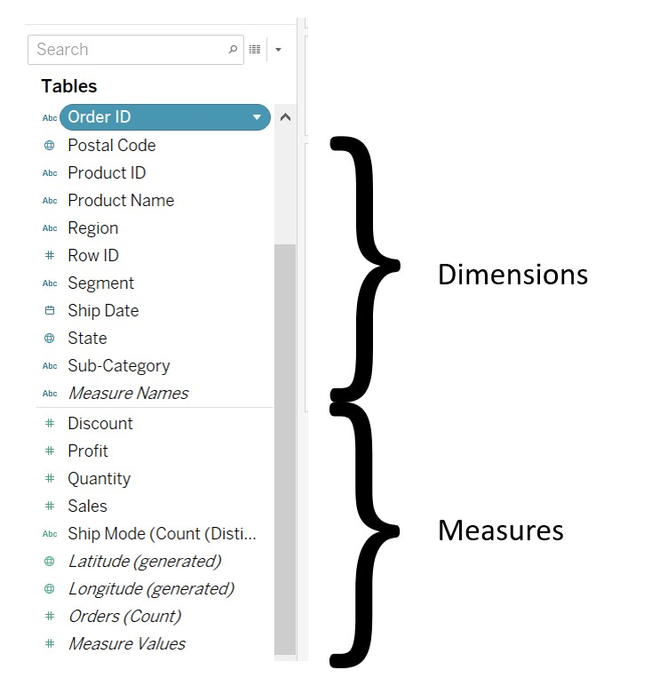
How to use the imported data?
Tableau automatically allocates each field in the dataset as a dimension or a measure (can be changed).
There are 24 different types of chart available in tableau.

Slide 22
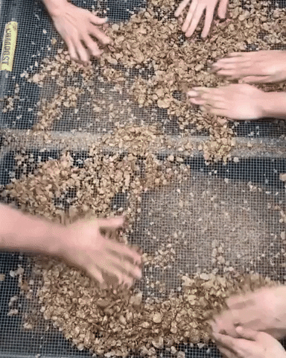
Fields
Measures
Quantitative data (Numeric, quantitative values)
Dimensions
Qualitative data (Names, dates, geographical data)

Slide 23
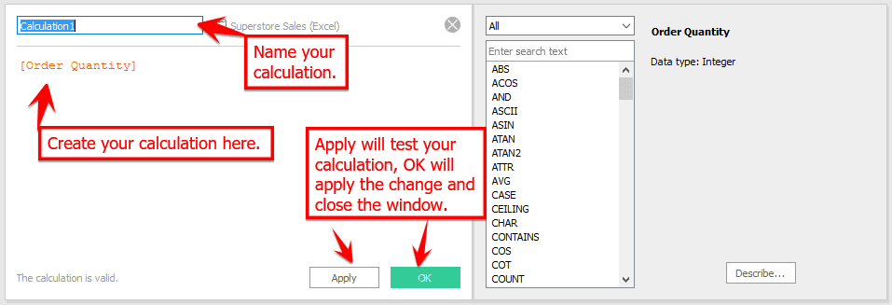
Calculated fields

Slide 24

Chart Types
Area Chart | Bubble Chart
Bar Chart | Line Chart
Box and Whisker plots | Histogram
Bullet Chart | Highlight Table
Scatter Plot | Gantt Chart
Pie Chart | Heat Map

Slide 25
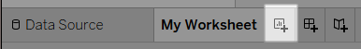

Ways to Visualize
A WORKSHEET - single view along with shelves, legends, and the Data pane. A DASHBOARD - collection of views from multiple worksheets. A STORY - sequence of worksheets or dashboards that work together to convey information.

Slide 26

What happens in the background?
VizQL- Visual Query Language (database visualization programming language) to query relational databases, cubes, cloud databases, and spreadsheets before generating various graph kinds.
These graphs may be used to create dashboards that can be shared through a computer network or the internet.

Slide 27

Looks like a lot of work, huh?

Slide 28

Welcome to the world of Data!

Slide 29

When was the last time I used Tableau?
AirBnB and Zillow Analysis:
Data: Publicly accessible Zillow and AirBnB data,
Goal:
Offer insights to a real estate company to assist them in developing a data product.
Determine which zip codes in New York City would make the highest profit on short-term rentals.
Deliverables: Dashboards

Slide 30
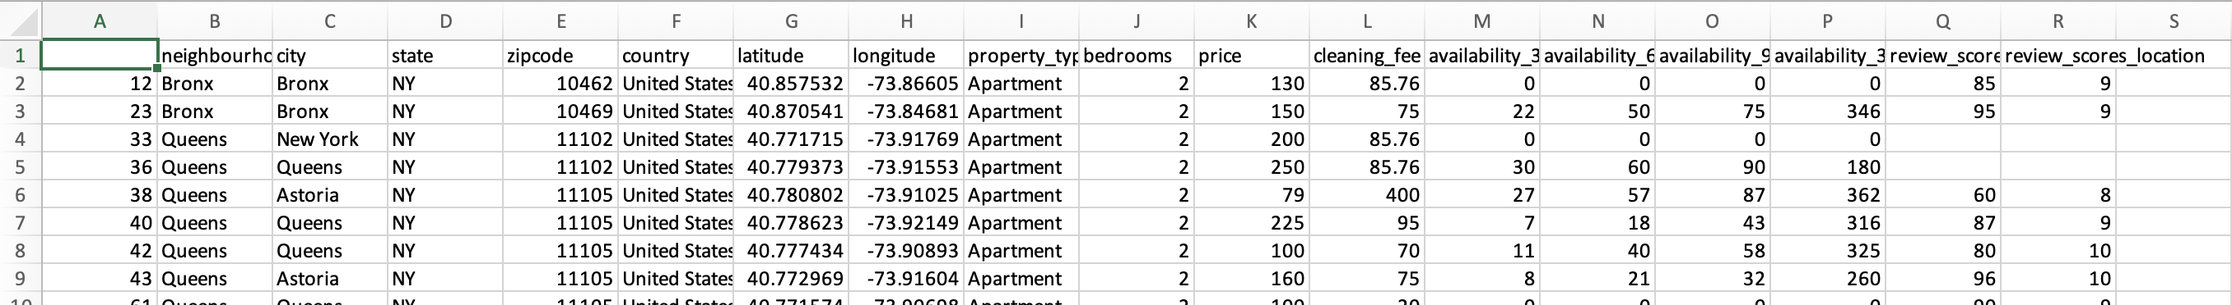

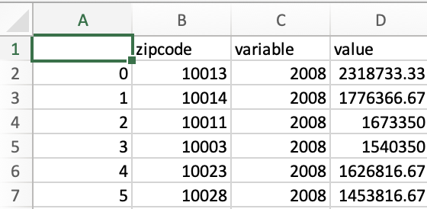
How did the data look like?
AirBnB
Zillow

Slide 31
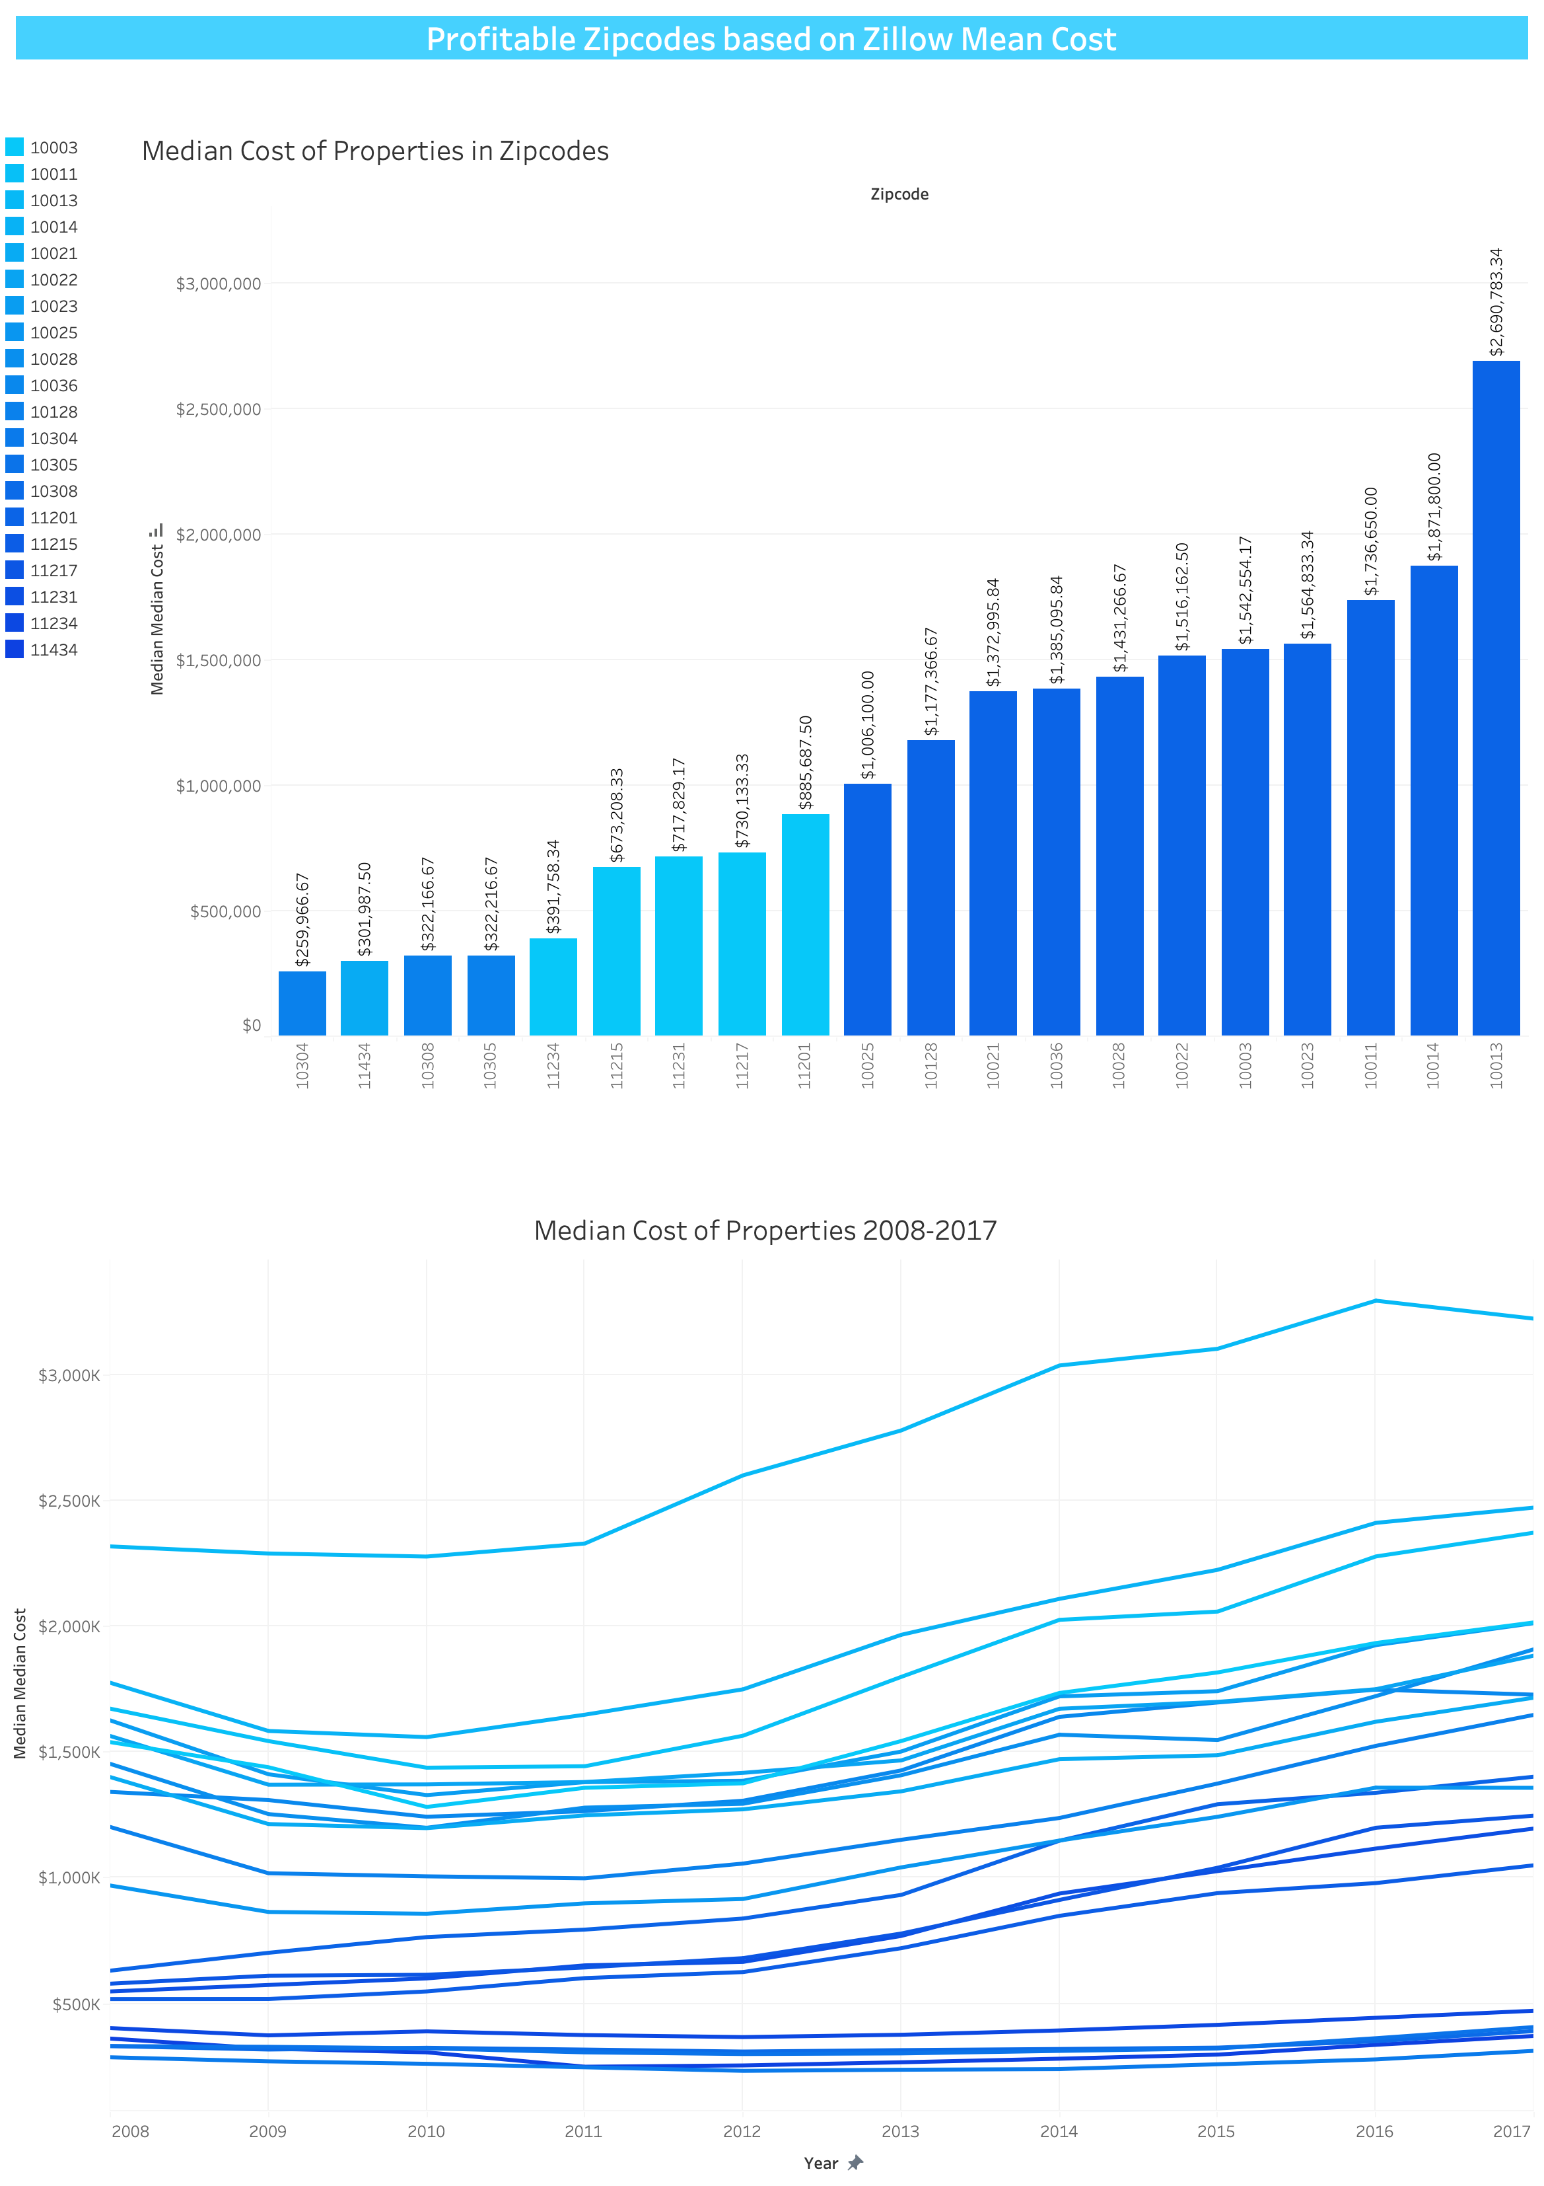
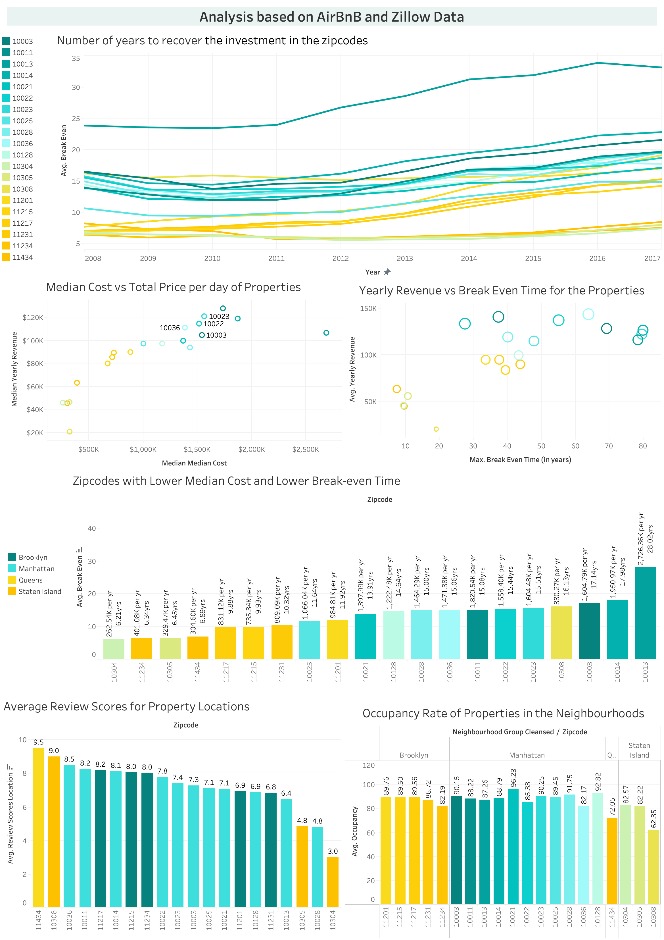
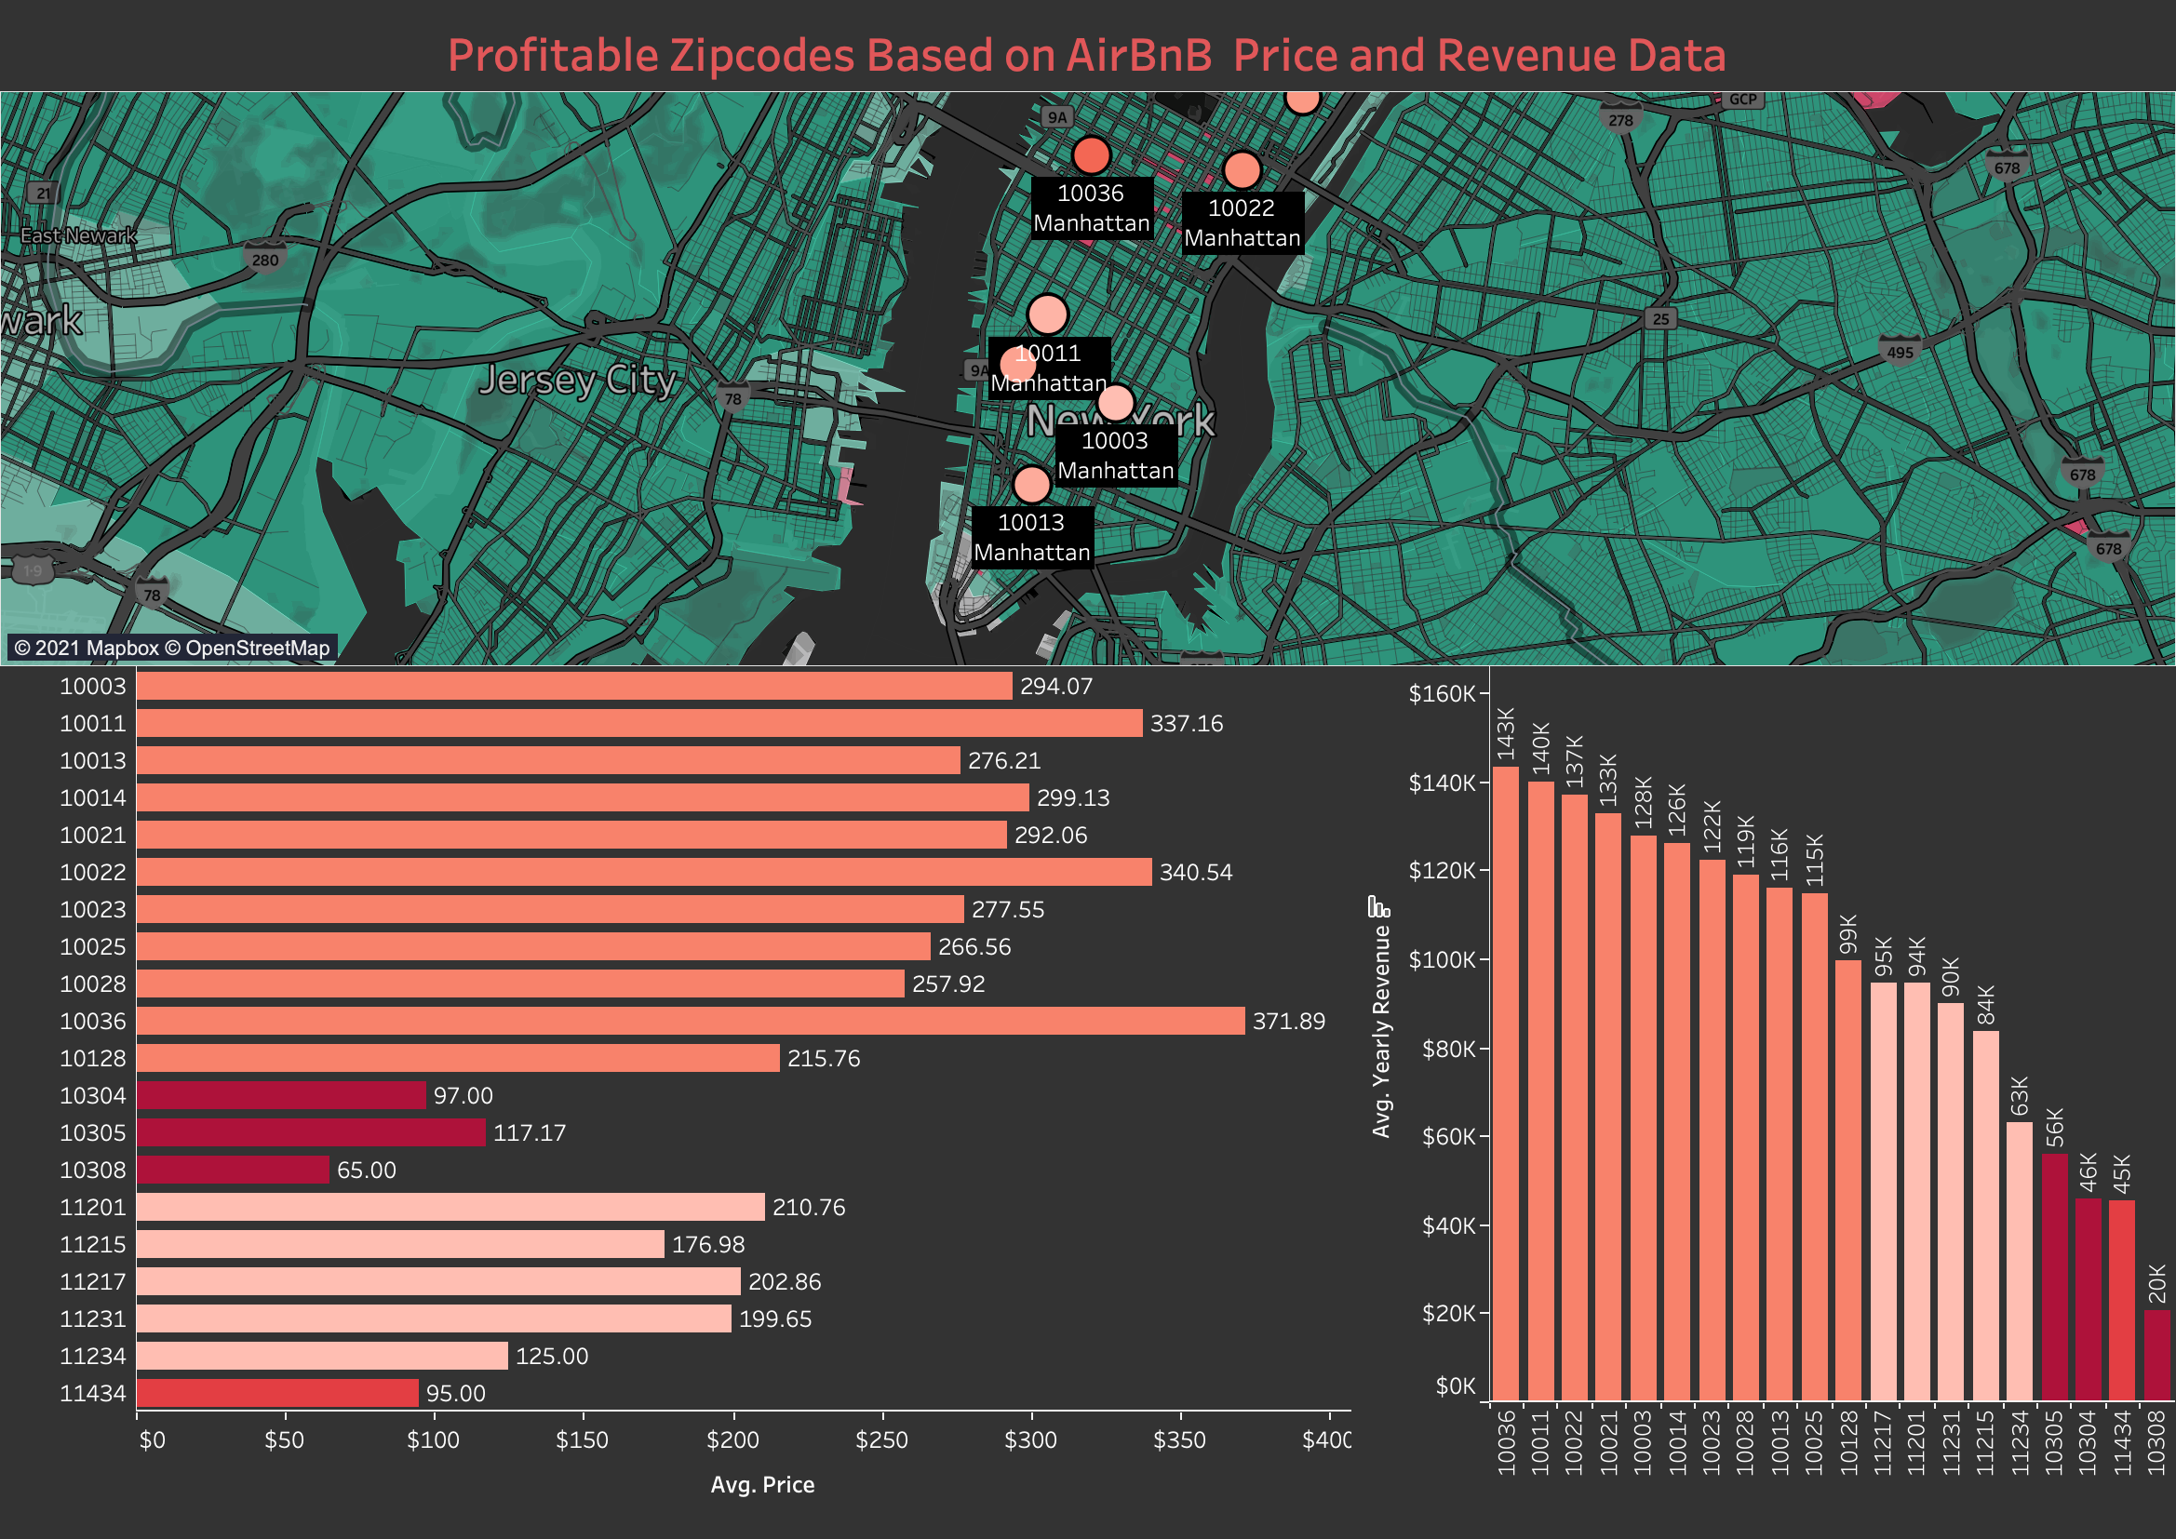
And what did I make out of it?

Slide 32

How did I do it?
Microsoft Excel: Dataset review.
Python: Data loading, data munging, wrangling, and other operations, using Jupyter Notebook.
Microsoft Word: Report documentation.
Python and Tableau Desktop: Vizualizations.

Slide 33

Although it looks overwhelming, it is not!

Slide 34
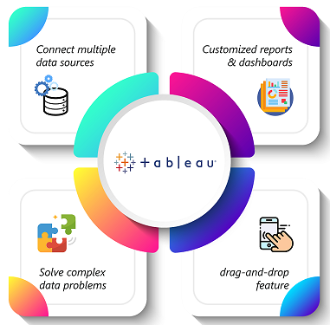
So, who was it meeting Tableau?

Slide 35


Slide 36
Thank you.

Slide 37
Let’s get in touch
Email:
isrinidhishukla@gmail.com
LinkedIn:
Srinidhi S (https://www.linkedin.com/in/srinidhishukla/)

Slide 38
References
Gifs: https://giphy.com/
Images and Content
- https://www.tableau.com/learn

